Slide 1

PROJECT PRESENTATION ON
Real Estate Valuation using Machine Learning
By
SAI PRAVEEN SURI
Reg. No. 21131F0065
IV Sem MCA
Under the guidance of
Mr. B. BALA KRISHNA
Assistant Professor
Department of Computer Applications
DEPARTMENT OF COMPUTER APPLICATIONS
GAYATRI VIDYA PARISHAD COLLEGE OF ENGINEERING (AUTONOMOUS)
VISAKHAPATNAM- 530048
2021-2023

Slide 2

CERTIFICATE
GAYATRI VIDYA PARISHAD COLLEGE OF ENGINEERING
(AUTONOMOUS)
This is to certify that the Industry Oriented Main Project entitled “REAL ESTATE VALUATION USING MACHINE LEARNING” being submitted by SURI SAI PRAVEEN with Register No. 21131F003065 Student of Gayatri Vidya Parishad College of Engineering (Autonomous), During the academic year 2021-2023.
Internal Guide Head of the Department
Mr. B. Balakrishna Dr. Y. Anuradha
Assistant Professor Associate Professor& Head
Department of Computer Applications Department of Computer Applications

Slide 3
Real Estate Valuation Using Machine Learning

Slide 4
OUTLINES OF THE PRESENTATION
Abstract
Literature review
Introduction
Existing System
Proposed System
System Requirements
Functional Requirements
Non-Functional Requirements
Architecture
Block Diagram
Algorithm
Sample Code
Output Screenshots
Conclusion

Slide 5
ABSTRACT
Buying a dream house is a common aspiration for people in these days, but accurately predicting its price has become more challenging, especially for those without expertise in this field. This difficulty often hinders informed decision-making when it comes to purchasing property. However, there is a proposed system that aims to simplify house price prediction by considering crucial factors. The system utilizes multiple regression techniques and bases on their performance through weighted averaging, leading to highly accurate predictions. This approach minimizes error and enhances accuracy.

Slide 6
LITARETURE REVIEW
[1] Li, J., Liu, C., Zhang, H."XGBoost for Real Estate Valuation: A Comparative Study".International Journal of Geographical Information Science, 2020.
This study focuses on the use of the XGBoost algorithm for real estate valuation. The authors conducted a comparative analysis of XGBoost with other machine learning models, using a dataset of residential properties. The results demonstrated that XGBoost outperformed the other models in terms of accuracy and feature importance, indicating its effectiveness for real estate valuation tasks.
[2] Zhao, X., Li, H., Wang, Y."Gaussian Process Regression for Real Estate Valuation: A Comprehensive Study".Computers, Environment and Urban Systems, 2022.
This research explores the application of Gaussian process regression (GPR) for real estate valuation. The authors conducted a comprehensive study to evaluate the performance of GPR using a dataset of residential properties. The findings demonstrated the effectiveness of GPR in capturing complex patterns and achieving accurate predictions in real estate valuation.

Slide 7
[3] Chen, T., Liu, Y., Liu, X."Real Estate Valuation Using Support Vector Regression: A Comparative Study".International Journal of Computational Intelligence Systems, 2019.
This study focuses on the application of support vector regression (SVR) for real estate valuation. The authors compared SVR with other machine learning models and evaluated their performance using a dataset of residential properties. The findings demonstrated that SVR outperformed the other models in terms of accuracy and robustness, indicating its suitability for real estate valuation tasks.

Slide 8
INTRODUCTION
House marketing is a complex and dynamic system influenced by various factors such as floors, size, amenities, and market trends. Predicting house prices accurately is essential for both buyers and sellers to make informed decisions. Regression is a widely used statistical technique that assumes a linear relationship between the independent variables (such as square footage, number of bedrooms, etc.) and the dependent variable (house price). By analyzing historical housing data and applying some regressions, we can create a model that can estimate the price of a house based on its characteristics.

Slide 9
EXISTING SYSTEM
When using the Support Vector Machine algorithm to predict house prices in the existing system, there are number of challenges that can arise. One of these challenges is the quality and quantity of data used for training. If there is no enough data or the data is of poor quality, the model gives less accuracy. Then may not be able to accurately predict house prices.

Slide 10
PROPOSED SYSTEM
The proposed system is to predict the house price index using some regression involves connecting a data set of house sale prices and their features, preprocessing the data, splitting it into training and testing sets, training model on the training set, evaluating the model’s accuracy on the testing set and deploying it for use. By using the best regression model, the system predicts the price of a house based on its features, such as the house type, size, bhk and location. The system is useful for homeowners, buyers, and real estate agents to estimate the value of a house and make informed decisions

Slide 11
SYSTEM REQUIREMENTS
MINIMUM HARDWARE REQUIREMENTS:
Processor : Intel I3
RAM : 8GB
Hard Disk : 128 GB
SOFTWARE REQUIREMENTS:
Operating System : Windows 7 (64bit)
Programming language : Python, html, CSS
Framework : Flask
Database :SQL Yog

Slide 12
FUNCTIONAL REQUIREMENTS
USER REGISTRATION:
Users should be able to register with the application by providing their name, email, password, and contact number.
DATASET UPLOAD:
Users should be able to upload a dataset in CSV format containing real estate property information.
DATASET SPLITTING:
Users should be able to split the dataset into training and testing sets.
Model Training and Evaluation:
The application should support multiple regression algorithms, such as Linear Regression, Decision Tree Regressor, K-Nearest Neighbors Regressor.

Slide 13
NON-FUNCTIONAL REQUIREMENTS
PERFORMANCE:
The system should be capable of handling big datasets effectively, ensuring minimum processing time for training and prediction.
RELIABILITY:
The system should provide a reliable environment for the user to ensure that predictions are consistent .
AVAILABILITY:
The system will be available by 24/7.

Slide 14
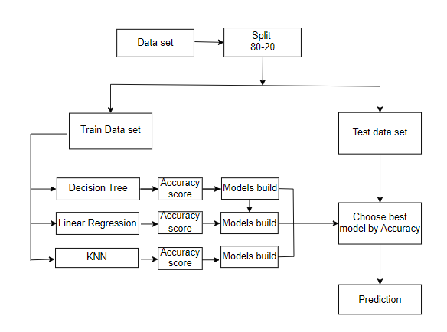
ARCHITECTURE
Figure-3: Architecture

Slide 15
ALGORITHMS
LINEAR REGRESSION :
Linear regression is a supervised learning algorithm used to analyze the relationship between a dependent variable and one or more independent variables. It aims to find the best-fitting linear equation that describes the linear relationship between the variables.
STEPS :
Identify the dependent and independent variables.
Calculate the slope and intercept.
Fit the line to the data.
Assess the model's goodness of fit.
Make predictions using the regression equation.
Evaluate the statistical significance of coefficients.

Slide 16
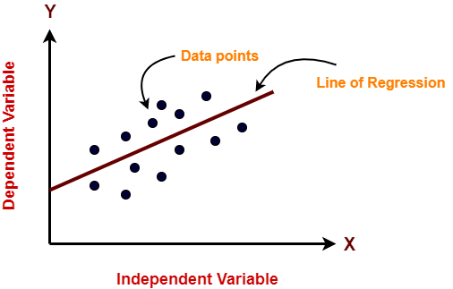
Make predictions using the regression equation.
Evaluate the statistical significance of coefficients.
Linear Regression Graph

Slide 17
Linear regression Algorithm code:
regressor_LR = LinearRegression()
regressor_LR.fit(X_train, y_train)
from sklearn.metrics import mean_squared_error, r2_score
y_pred_lin = regressor_LR.predict(X_test)
accuracyscore = mean_squared_error(y_test, y_pred_lin)
R2Score = r2_score(y_test, y_pred_lin)
print("Linear Regression")
print(R2Score)
return render_template('model_performance.html', j='Linear regression’, acc=R2Score, model=model_no,

Slide 18
Decision Tree Algorithm:
Decision Tree:
The supervised learning approach known as a decision tree may be applied to classify and regression issues, although it is most typically utilized to deal with classification challenges. It is a tree-structured classifier, with internal nodes standing in for dataset characteristics, branches for decision-making procedures, and leaf nodes for conclusions.
Steps :
Identify the tree's root.
Split the data based on select feature.
Repeat the splitting process until a stopping condition is met.
Set labels to every single leaf node.

Slide 19
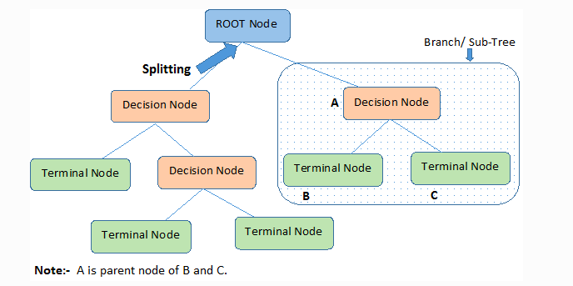
Prune the tree.
Make predictions by traversing the tree from root to leaf node.
Evaluate the model.

Slide 20
Decision tree Algorithm code:
regressor_LR = DecisionTreeRegressor(random_state=0)
regressor_LR.fit(X_train, y_train)
from sklearn.metrics import mean_squared_error, r2_score y_pred_lin = regressor_LR.predict(X_test)
accuracyscore = mean_squared_error(y_test, y_pred_lin)
R2Score = r2_score(y_test, y_pred_lin) print("Decision Tree Regressor")
print(R2Score)

Slide 21
K-NEAREST NEIGHBOR (KNN):
K-Nearest Neighbors (KNN) is a machine learning technique used for classification and regression tasks.
It functions by locating the k average data points in the training set to a given input sample.
The method predicts the class or value of the input based on the majority vote (for classification) or the average (for regression) of the neighbors.
STEPS:
Choose the k-number of neighbors.
Find the neighbors Euclidian distances using k.
Determine the k nearest neighbors in accordance with the calculation.
Count the number of data points in each category among the k neighbors.
Stop the operation.

Slide 22
KNN Algorithm code:
regressor_LR = KNeighborsRegressor()
regressor_LR.fit(X_train, y_train)
from sklearn.metrics import mean_squared_error, r2_score
y_pred_lin = regressor_LR.predict(X_test)
accuracyscore = mean_squared_error(y_test, y_pred_lin)
R2Score = r2_score(y_test, y_pred_lin)
print("KNeighbors Regressor")
print(R2Score)
return render_template('model_performance.html', j='KNeighborsRegressor’, acc=R2Score, model=model_no,
score=accuracyscore, msg='suc')

Slide 23
SAMPLE CODE
import pandas as pd
from flask import Flask, render_template, request, url_for, flash, redirect, session
from sklearn.metrics import r2_score
import matplotlib.pyplot as plt
import numpy as np
import pymysql
webapp = Flask(__name__)
db = pymysql.connect(host='localhost', user='root', password='', db='house_price_prediction')
cursor = db.cursor()
webapp.config['UPLOAD_FOLDER'] = r"dataset"
@webapp.route("/")
def main():
return render_template("home.html")
@webapp.route("/reg", methods=['POST', 'GET'])
def reg():
if request.method == 'POST':
# Registration code
return render_template("reg.html", message="register")
return render_template("reg.html")

Slide 24
@webapp.route("/login", methods=['POST', 'GET'])
def login():
if request.method == 'POST':
# Login code
return render_template('login.html')
@webapp.route("/upload", methods=['POST', 'GET'])
def upload():
if request.method == 'POST':
# File upload code
return render_template("uploaddataset.html")
@webapp.route("/View")
def View():
# View code
return render_template("View.html")
@webapp.route('/split', methods=['POST', 'GET'])
def split():
if request.method == "POST":
# Dataset splitting code
return redirect(url_for('model_performance'))
return render_template('split_dataset.html')

Slide 25
@webapp.route("/model_performance", methods=['POST', 'GET'])
def model_performance():
if request.method == "POST":
model_no = int(request.form['algo'])
if model_no == 0:
print("You have not selected any model")
elif model_no == 1:
# Linear Regression code
score=accuracyscore, msg='success')
elif model_no == 2:
# Decision Tree Regressor code
return render_template('model_performance.html', j='Decision Tree Regressor', acc=R2Score,
elif model_no == 3:
# KNeighborsRegressor code
return render_template('model_performance.html', j='KNeighborsRegressor', acc=R2Score, model=model_no,
@webapp.route('/prediction', methods=['POST', 'GET'])
def prediction():
if request.method == 'POST':
# Prediction code
return render_template('prediction.html', pred=p, mdf='jhgj')
return render_template('prediction.html')

Slide 26
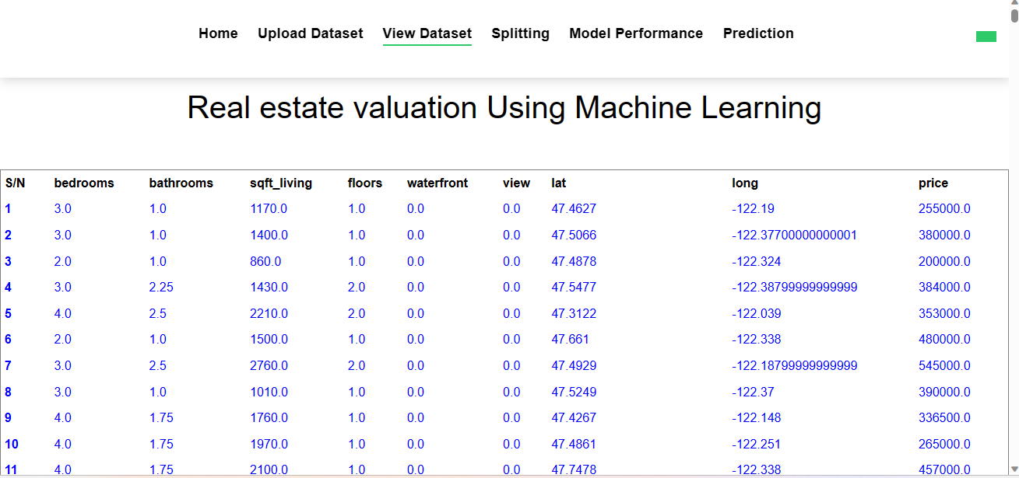
DATASET
Figure 1: Data set

Slide 27
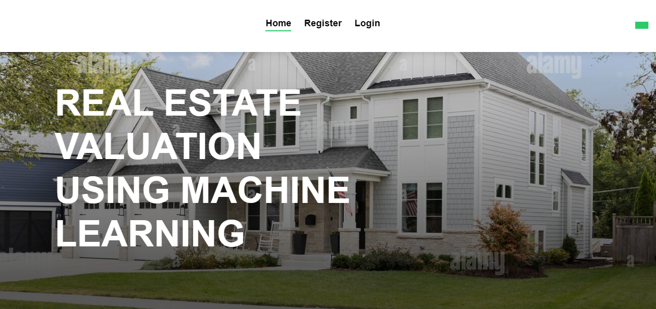
OUTPUT SCREENSHOTS:
Figure 2: Home page

Slide 28
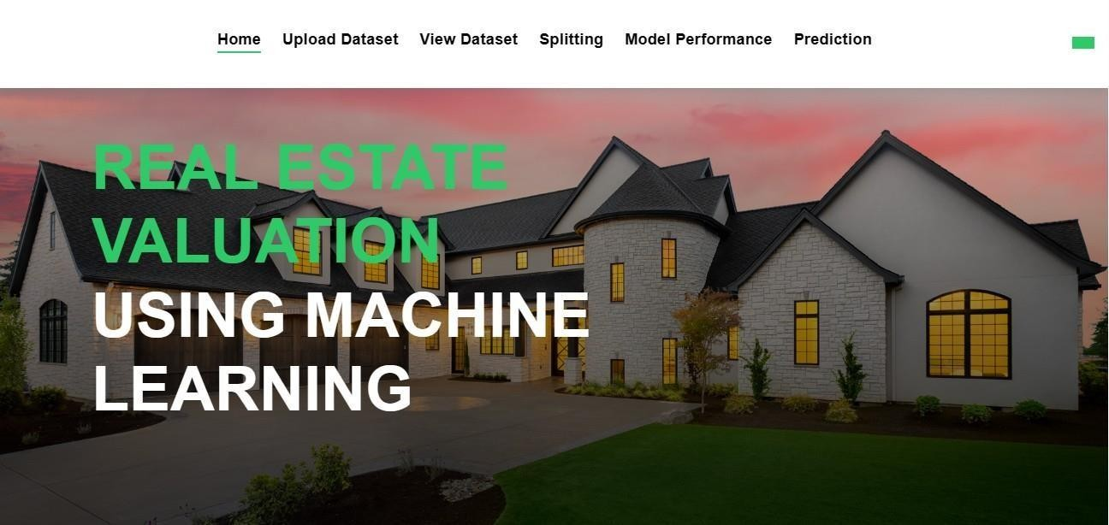
Figure 3:Register page

Slide 29
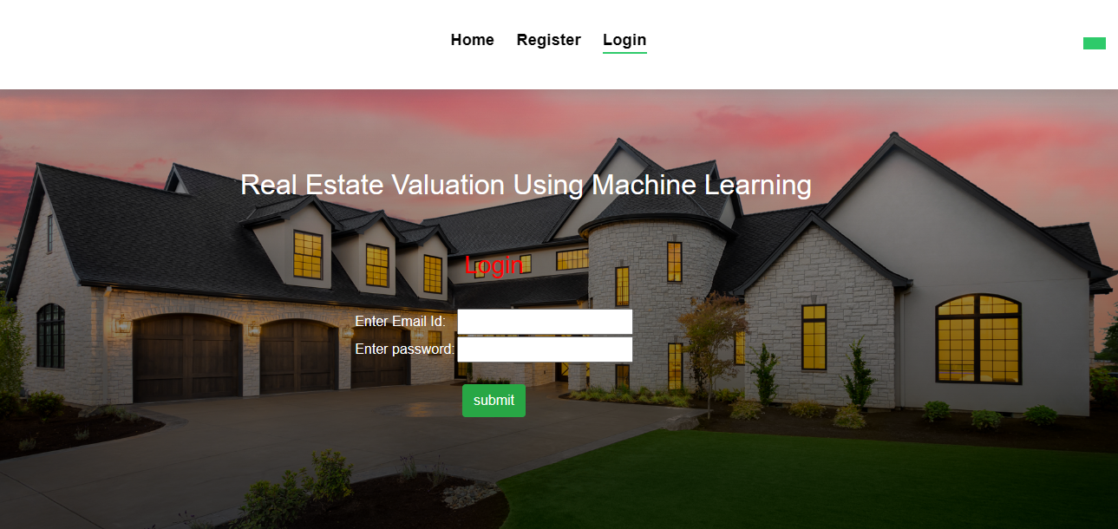
Figure 4: login Page

Slide 30
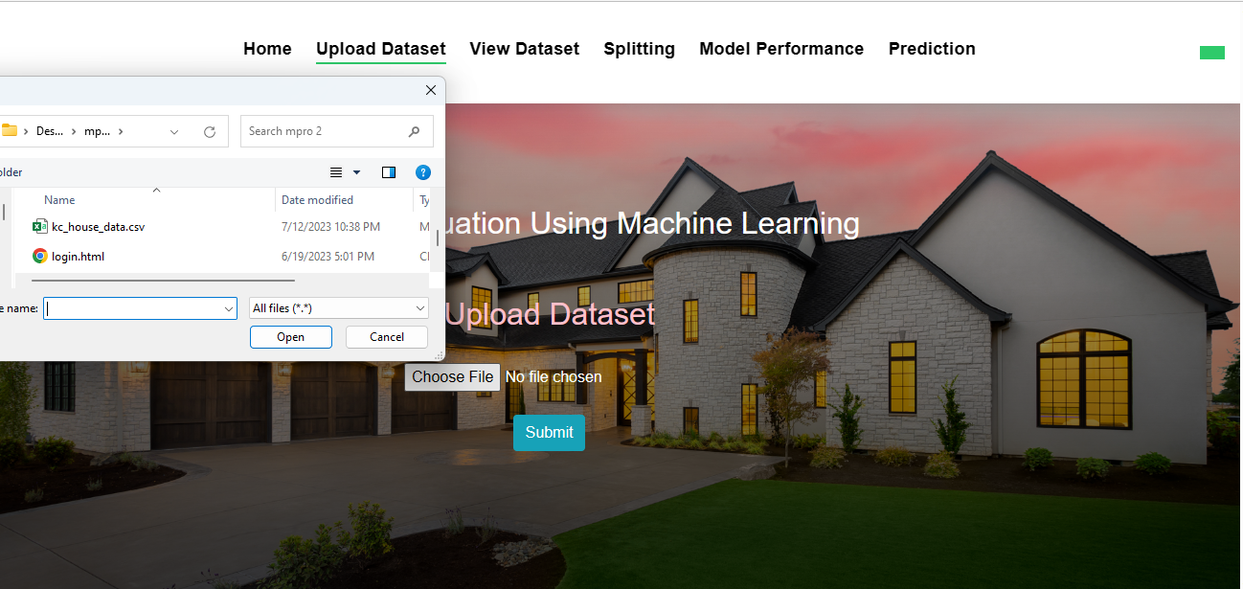
Figure 5: Upload dataset

Slide 31
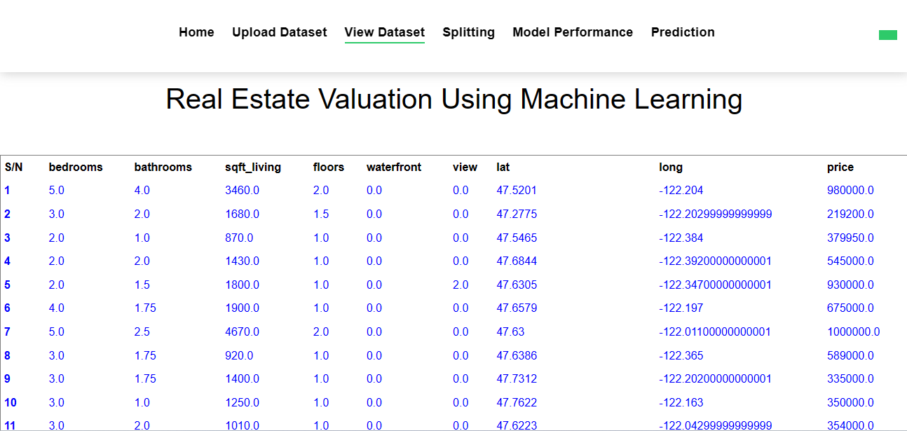
Figure 7: view dataset Page

Slide 32
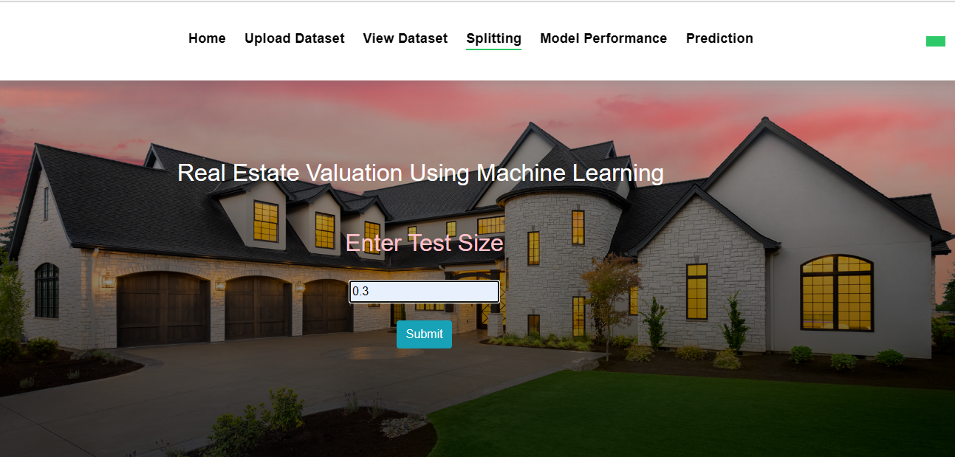
Figure 8: split the data set Page

Slide 33
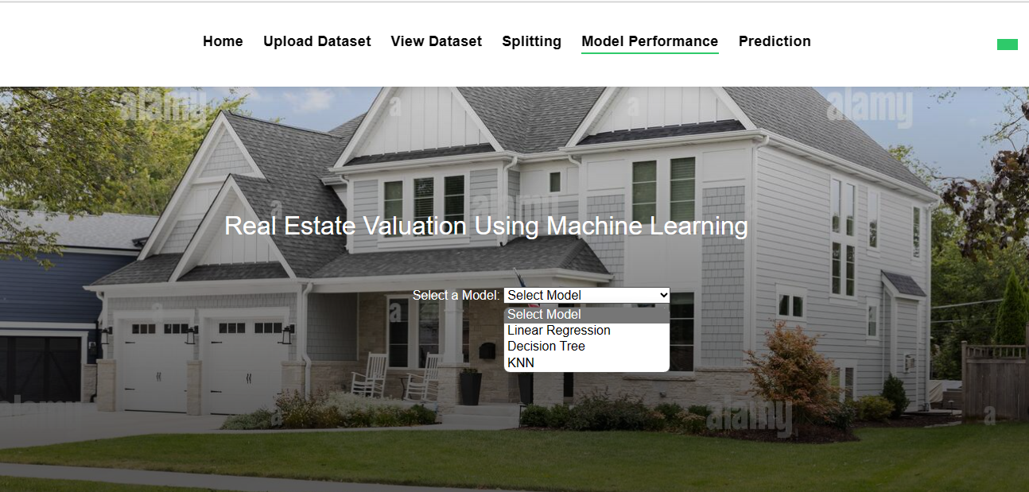
Figure 9: model selection Page

Slide 34
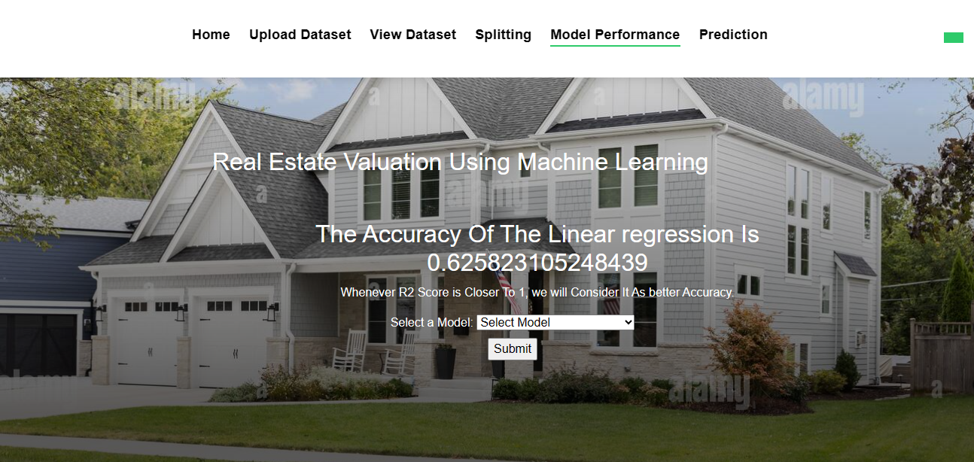
Figure 10: Accuracy Page

Slide 35
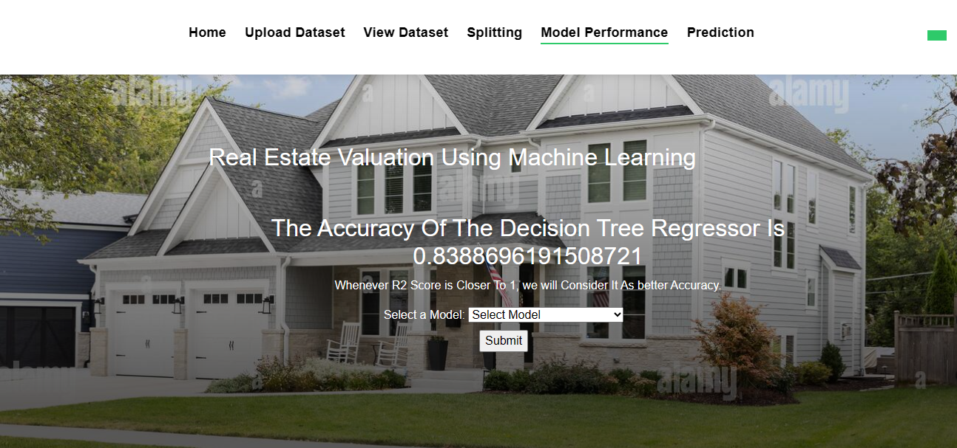
Figure 11: Accuracy Page

Slide 36
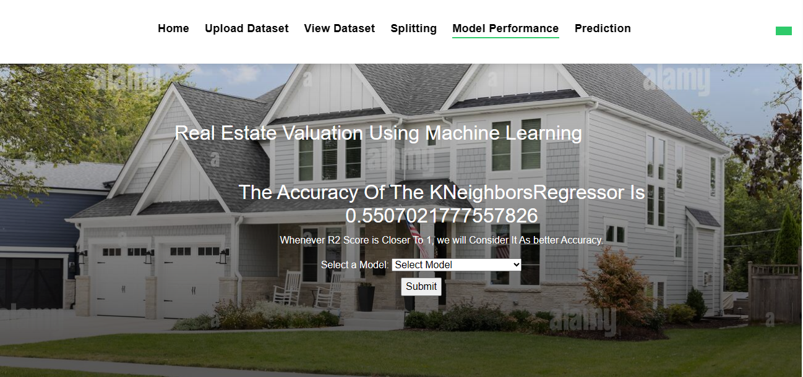
Figure 12: Accuracy Page

Slide 37
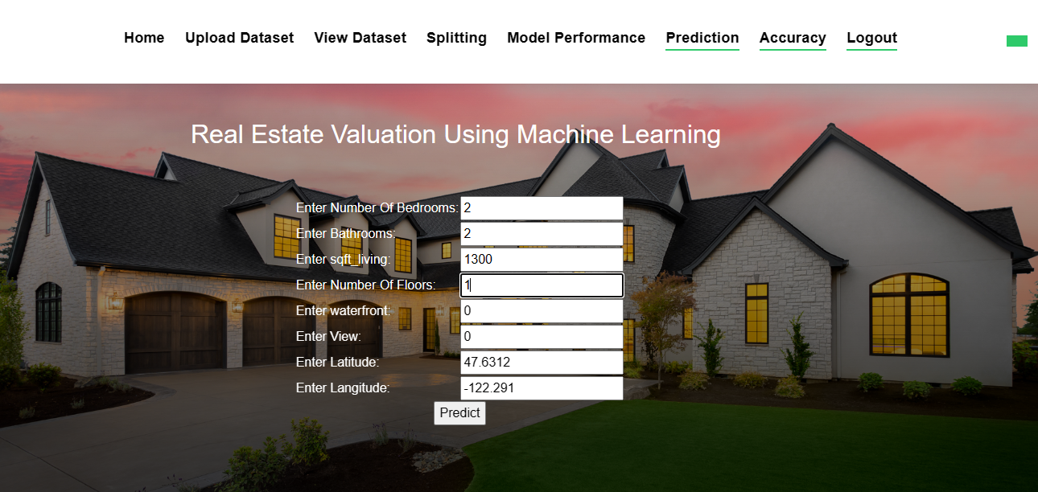
Figure 14: input Page

Slide 38
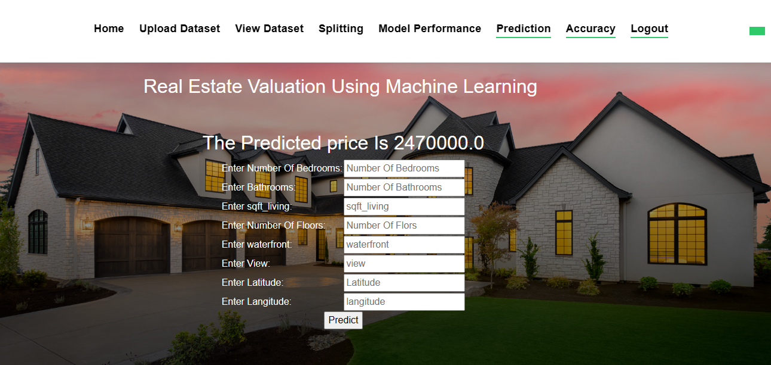
Figure 15: prediction Page

Slide 39
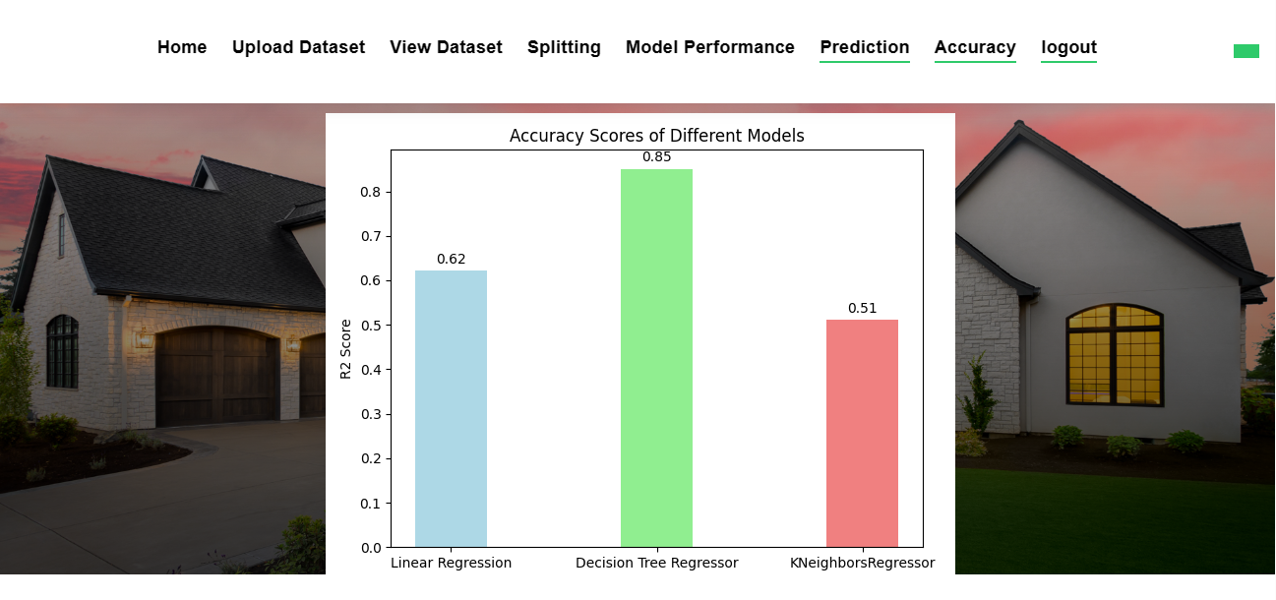
Figure 16: accuracy graph Page

Slide 40
CONCLUSION:
This system mainly concentrates on the comparison between different machine learning algorithms (Linear regression, Decision Tree, KNN) about Real estate valuation Analysis. From the system results, Decision Tree algorithm has high accuracy value when compared to all the other algorithms regarding real estate valuation. Here the [MSE] Mean Square Error and R2 score are used to calculate the accuracy value of the algorithm on the King County Dataset which was collected from Kaggle website. They can be extended by applying the above said algorithms to predict House value.

